Slide 1
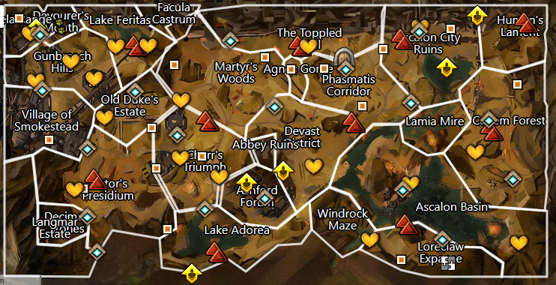








1-rytlock-welcome soldier/cub – help out around. I’ll head to Ashford Forum and dispatch a soldier to guide you at old duke’s estate. Something stirred up the ghosts and we need to find out what.
2-bls-head to crypt for clues
3-bls-no clues but ash legion reported activity to the south west
4-bls-unless you’ve been eating fermented devourer eggs, I smell sulfur and sulfur means flame legion. Lets head east
5- bls-intro: gaheron balefire as a dropped note. Head north to report in
6-rytlock-snarls gaheron balefire. Go north to check the site of a searing stone
7-bls-nothing but grawl. Head south to report back to rtylock
8-rytlock-ghosts, fire legion and now separatists. Recon the shores east of ascalon basin, but start by heading east and root out the rebels.
9- bls-those filthy separatists we need to find their encampment and rip it to shreds
10-bls-one of them reported finding a locked treasure chest in the ruins. Lets see if we can reclaim something for the blood legion
11-bls-why is it always traps
12-bls-what an… interesting little talking rat. Well lets continue north on our recon
13-bls-those ogres really know how to put up a fight but I don’t think they have much todo with flame legion. Lets head over to the catacombs to finish our recon
14-rytlock-good job with those separatists. I am setting up to go clear out these catacombs in a few days. With no signs of the fire legion to the east, head northwest into Diessa plateau and see if we can smoke them out.
15
14a
1
1a
1b
2
7
14
13
6a
3
7a
6
3a
8
9
4a
12
4
5
10
11

Slide 2
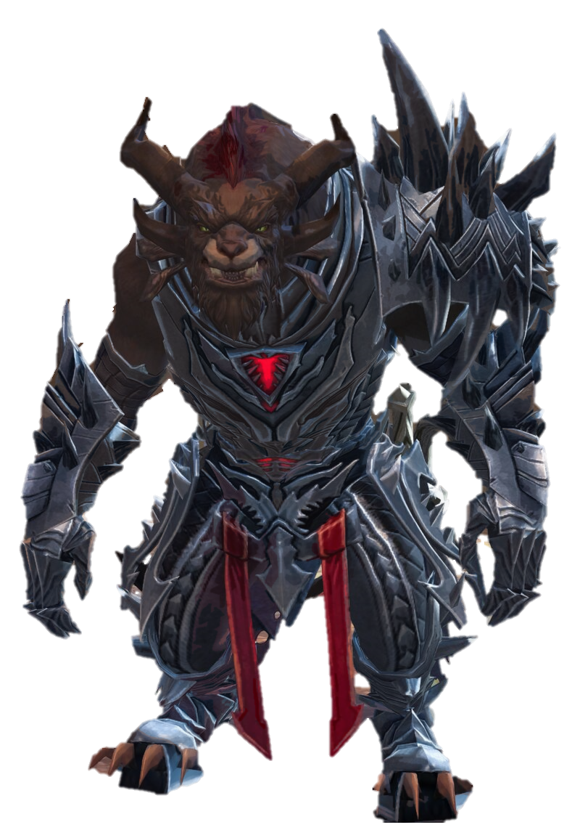

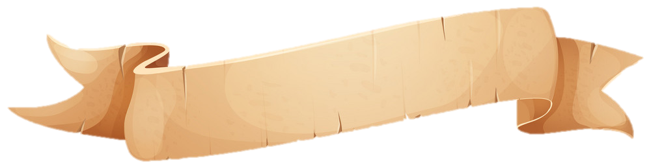
Text
text.
1
Rytlock

Slide 3
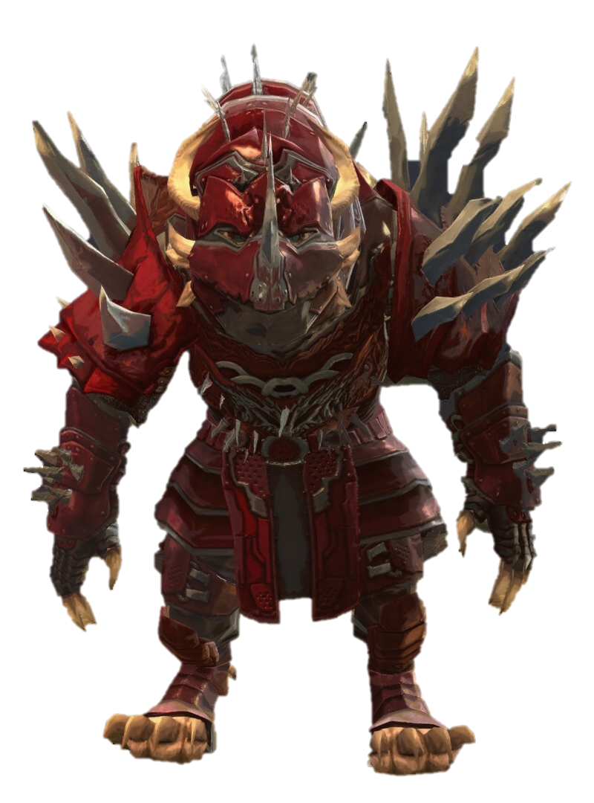
text.
text.
Text
text.
1
2

Slide 4
text.
text.
Text
text.
1
2

Slide 5


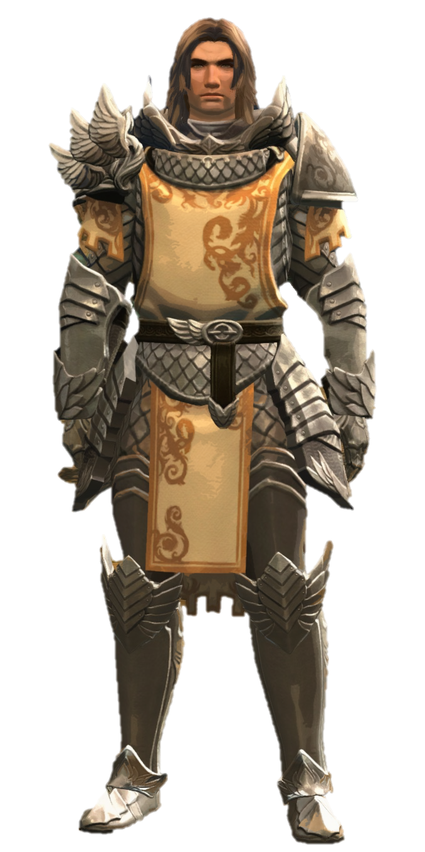
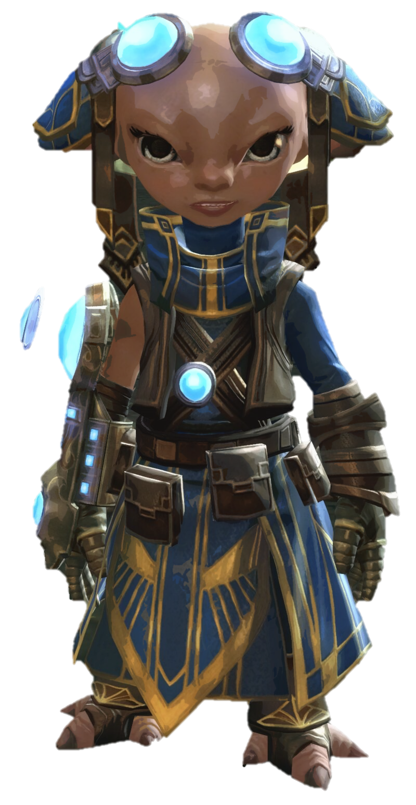

Slide 6
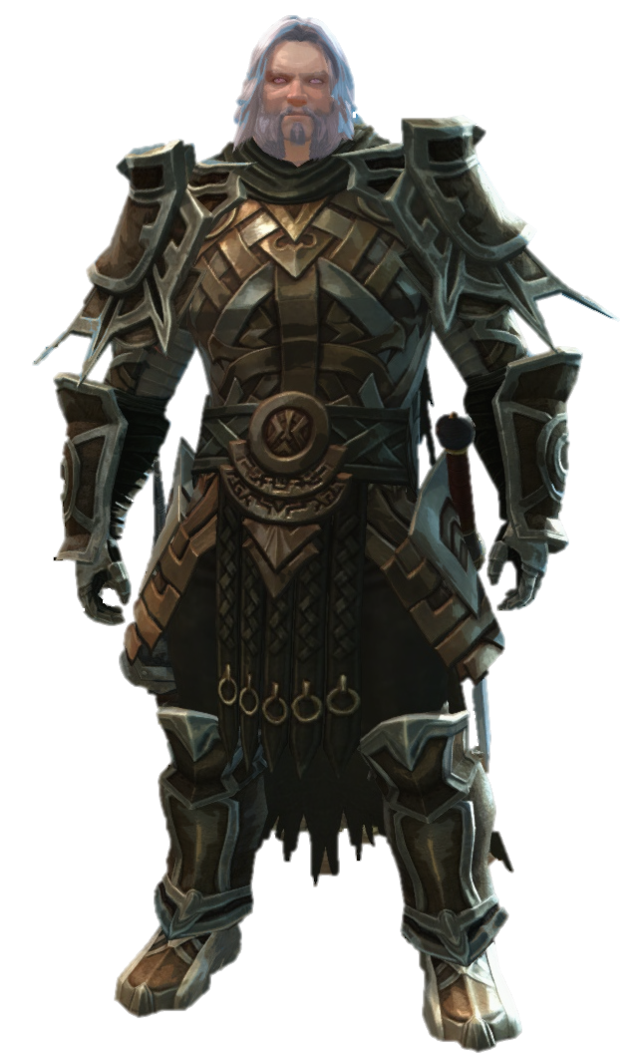

Slide 7
